Slide 1
ChatConnect -
A Real-Time Chat And Communication App
Aswin Raksha S 80D73CEB36332BCA2C24D5A4567FBCCA

Slide 2
DESCRIPTION
ChatConnect is an interactive communication platform designed for seamless messaging, built with Android’s Compose UI toolkit. It enables real-time text messaging, making it easy for users to connect and communicate efficiently.
Compose UI Integration: ChatConnect showcases Compose's modern, declarative approach to UI design, allowing smooth, responsive, and adaptive user interfaces.
Real-Time Messaging: With efficient state management, messages appear instantly as they are sent and received, enhancing the immediacy and fluidity of conversations.
File Sharing: ChatConnect supports sharing various file types, including images, ZIP files, PDFs, and more, making it a versatile tool for sharing multimedia and documents during chats.
Firebase Integration: Utilizing Firebase, ChatConnect provides a robust backend for message storage and retrieval, enabling real-time updates in chat windows.
User-Friendly Navigation: Through composable functions, the app demonstrates seamless navigation, enhancing usability and guiding users intuitively through chat threads.
ChatConnect serves as a foundational project for developers looking to understand and implement chat functionalities in Android, leveraging the power of Compose for a modern and streamlined UI experience.

Slide 3
ChatActivity.kt:
package com.chat.chatapp
import android.content.Intent
import androidx.appcompat.app.AppCompatActivity
import android.os.Bundle
import android.widget.EditText
import android.widget.ImageView
import androidx.recyclerview.widget.LinearLayoutManager
import androidx.recyclerview.widget.RecyclerView
import com.google.firebase.auth.FirebaseAuth
import com.google.firebase.database.*
class ChatActivity : AppCompatActivity() {
private lateinit var chatRecyclerView: RecyclerView
private lateinit var messageBox: EditText
private lateinit var sendButton: ImageView
private lateinit var messageAdapter: MessageAdapter
private lateinit var messageList: ArrayList<Message>
private lateinit var mDbRef: DatabaseReference
var receiverRoom: String? = null
var senderRoom: String? = null

Slide 4
override fun onCreate(savedInstanceState: Bundle?) {
super.onCreate(savedInstanceState)
setContentView(R.layout.activity_chat)
val name = intent.getStringExtra("name")
val receiverUid = intent.getStringExtra("uid")
val senderUid = FirebaseAuth.getInstance().currentUser?.uid
mDbRef = FirebaseDatabase.getInstance().getReference()
senderRoom = receiverUid + senderUid
receiverRoom = senderUid + receiverUid
supportActionBar?.title = name
chatRecyclerView = findViewById(R.id.chatRecyclerView)
messageBox = findViewById(R.id.messageBox)
sendButton = findViewById(R.id.sentButton)
messageList = ArrayList()
messageAdapter = MessageAdapter(this, messageList)
chatRecyclerView.layoutManager = LinearLayoutManager(this)
chatRecyclerView.adapter = messageAdapter

Slide 5
// logic for adding data or chats to recycler view
mDbRef.child("chats").child(senderRoom!!).child("messages")
.addValueEventListener(object : ValueEventListener {
override fun onDataChange(snapshot: DataSnapshot) {
messageList.clear()
for (postSnapshot in snapshot.children) {
val message = postSnapshot.getValue(Message::class.java)
messageList.add(message!!)
}
messageAdapter.notifyDataSetChanged()
}
override fun onCancelled(error: DatabaseError) {
}
})
// adding the message to database
sendButton.setOnClickListener {
val message = messageBox.text.toString()
val messageObject = Message(message, senderUid)
mDbRef.child("chats").child(senderRoom!!).child("messages").push()
.setValue(messageObject).addOnSuccessListener {
mDbRef.child("chats").child(receiverRoom!!).child("messages").push()
.setValue(messageObject) }
messageBox.setText("")
} } }

Slide 6
LoginActivity.kt
package com.chat.chatapp
import android.content.Intent
import androidx.appcompat.app.AppCompatActivity
import android.os.Bundle
import android.widget.Button
import android.widget.EditText
import android.widget.Toast
import com.google.firebase.auth.FirebaseAuth
class LoginActivity : AppCompatActivity() {
private lateinit var edtEmail: EditText
private lateinit var edtPasswoord: EditText
private lateinit var btnLogin: Button
private lateinit var btnSignUp: Button
private lateinit var mAuth : FirebaseAuth
override fun onCreate(savedInstanceState: Bundle?) {
super.onCreate(savedInstanceState)
setContentView(R.layout.activity_login)

Slide 7
mAuth = FirebaseAuth.getInstance()
edtEmail = findViewById(R.id.edt_email)
edtPasswoord = findViewById(R.id.edt_Password)
btnLogin = findViewById(R.id.btn_Login)
btnSignUp = findViewById(R.id.btn_SignUp)
btnSignUp.setOnClickListener {
startActivity(Intent(this, SignupActivity::class.java))
}
btnLogin.setOnClickListener {
val email = edtEmail.text.toString()
val password = edtPasswoord.text.toString()
login(email,password)
}
val user = FirebaseAuth.getInstance().getCurrentUser()
if (user != null)
{
val intent = Intent(this, MainActivity::class.java)
startActivity(intent)
finish()
}
}

Slide 8
private fun login(email: String, password: String) {
mAuth.signInWithEmailAndPassword(email, password)
.addOnCompleteListener(this) { task ->
if (task.isSuccessful) {
// Sign in success, update UI with the signed-in user's information
val intent = Intent(this,MainActivity::class.java)
finish()
startActivity(intent)
} else {
// If sign in fails, display a message to the user.
Toast.makeText(this,"user not exist", Toast.LENGTH_LONG).show()
}
}
}
}
MainActivity.kt
package com.chat.chatapp
import android.content.Intent
import androidx.appcompat.app.AppCompatActivity
import android.os.Bundle

Slide 9
import android.view.Menu
import android.view.MenuItem
import androidx.recyclerview.widget.LinearLayoutManager
import androidx.recyclerview.widget.RecyclerView
import com.google.firebase.auth.FirebaseAuth
import com.google.firebase.database.*
class MainActivity : AppCompatActivity() {
private lateinit var userRecyclerView: RecyclerView
private lateinit var userList: ArrayList<User>
private lateinit var adapter: UserAdapter
private lateinit var mAuth: FirebaseAuth
private lateinit var mDbRef: DatabaseReference
override fun onCreate(savedInstanceState: Bundle?) {
super.onCreate(savedInstanceState)
setContentView(R.layout.activity_main)
mAuth = FirebaseAuth.getInstance()
mDbRef = FirebaseDatabase.getInstance().getReference()
userList = ArrayList()
adapter = UserAdapter(this, userList)

Slide 10
userRecyclerView = findViewById(R.id.userRecyclerView)
userRecyclerView.layoutManager = LinearLayoutManager(this)
userRecyclerView.adapter = adapter
mDbRef.child("user").addValueEventListener(object : ValueEventListener {
override fun onDataChange(snapshot: DataSnapshot) {
userList.clear()
for (postSnapshot in snapshot.children) {
val currentUser = postSnapshot.getValue(User::class.java)
if (mAuth.currentUser?.uid != currentUser?.uid) {
userList.add(currentUser!!)
}
}
adapter.notifyDataSetChanged()
}
override fun onCancelled(error: DatabaseError) {
}
})
}

Slide 11
override fun onCreateOptionsMenu(menu: Menu?): Boolean {
menuInflater.inflate(R.menu.menu, menu)
return super.onCreateOptionsMenu(menu)
}
override fun onOptionsItemSelected(item: MenuItem): Boolean {
if (item.itemId == R.id.logout) {
mAuth.signOut()
val intent = Intent(this, LoginActivity::class.java)
finish()
startActivity(intent)
return true
}
return true
}
}
Message.kt
package com.chat.chatapp
class Message {
var message:String? = null
var senderId: String? = null

Slide 12
constructor(){}
constructor(message:String?,senderId:String?){
this.message = message
this.senderId = senderId
}
}
MessageAdapter.kt
package com.chat.chatapp
import android.content.Context
import android.view.LayoutInflater
import android.view.View
import android.view.ViewGroup
import android.widget.TextView
import androidx.recyclerview.widget.RecyclerView
import com.google.firebase.auth.FirebaseAuth
class MessageAdapter(val context: Context, val messageList: ArrayList<Message>) :
RecyclerView.Adapter<RecyclerView.ViewHolder>() {
val ITEM_RECEIVE = 1
val ITEM_SENT = 2

Slide 13
override fun onCreateViewHolder(parent: ViewGroup, viewType: Int): RecyclerView.ViewHolder {
if (viewType == 1) {
// inflate receive
val view: View = LayoutInflater.from(context).inflate(R.layout.receive, parent, false)
return ReceiveViewHolder(view)
} else {
// inflate sent
val view: View = LayoutInflater.from(context).inflate(R.layout.sent, parent, false)
return SentViewHolder(view)
}
}
override fun onBindViewHolder(holder: RecyclerView.ViewHolder, position: Int) {
val currentMessage = messageList[position]
if (holder.javaClass == SentViewHolder::class.java) {
//stuff for sent view holder
val viewHolder = holder as SentViewHolder
holder.sentMessage.text = currentMessage.message
} else {
//stuff for receive view holder
val viewHolder = holder as ReceiveViewHolder
holder.receiveMessage.text = currentMessage.message
}
}

Slide 14
override fun getItemViewType(position: Int): Int {
val currentMessage = messageList[position]
if (FirebaseAuth.getInstance().currentUser?.uid.equals(currentMessage.senderId)) {
return ITEM_SENT
} else {
return ITEM_RECEIVE
}
}
override fun getItemCount(): Int {
return messageList.size
}
class SentViewHolder(itemView: View) : RecyclerView.ViewHolder(itemView) {
val sentMessage = itemView.findViewById<TextView>(R.id.txt_sent_message)
}
class ReceiveViewHolder(itemView: View) : RecyclerView.ViewHolder(itemView) {
val receiveMessage = itemView.findViewById<TextView>(R.id.txt_receive_message)
}
}

Slide 15
SignupActivity.kt
package com.chat.chatapp
import android.content.Intent
import androidx.appcompat.app.AppCompatActivity
import android.os.Bundle
import android.widget.Button
import android.widget.EditText
import android.widget.Toast
import com.google.firebase.auth.FirebaseAuth
import com.google.firebase.database.DatabaseReference
import com.google.firebase.database.FirebaseDatabase
class SignupActivity : AppCompatActivity() {
private lateinit var edtEmail: EditText
private lateinit var edtPasswoord: EditText
private lateinit var edtName: EditText
private lateinit var btnSignUp: Button
private lateinit var mAuth: FirebaseAuth
private lateinit var mDbRef: DatabaseReference
override fun onCreate(savedInstanceState: Bundle?) {
super.onCreate(savedInstanceState)
setContentView(R.layout.activity_signup)

Slide 16
mAuth = FirebaseAuth.getInstance()
edtName = findViewById(R.id.edt_Name)
edtEmail = findViewById(R.id.edt_email)
edtPasswoord = findViewById(R.id.edt_Password)
btnSignUp = findViewById(R.id.btn_SignUp)
btnSignUp.setOnClickListener {
val name = edtName.text.toString()
val email = edtEmail.text.toString()
val password = edtPasswoord.text.toString()
signUp(name,email,password)
}
}
private fun signUp(name: String, email: String, password: String) {
mAuth.createUserWithEmailAndPassword(email, password)
.addOnCompleteListener(this) { task ->
if (task.isSuccessful) {
addUserToDatabase(name, email, mAuth.currentUser?.uid!!)
// Sign in success, update UI with the signed-in user's information
val intent = Intent(this,MainActivity::class.java)
finish()
startActivity(intent)

Slide 17
} else {
// If sign in fails, display a message to the user.
Toast.makeText(this, "error", Toast.LENGTH_LONG).show()
}
}
}
private fun addUserToDatabase(name: String, email: String, uid: String?) {
mDbRef = FirebaseDatabase.getInstance().getReference()
mDbRef.child("user").child(uid!!).setValue(User(name,email,uid))
}
}
SplashActivity.kt
package com.chat.chatapp
import android.content.Intent
import androidx.appcompat.app.AppCompatActivity
import android.os.Bundle
import android.os.Handler
import androidx.appcompat.app.AppCompatDelegate

Slide 18
class SplashActivity : AppCompatActivity() {
override fun onCreate(savedInstanceState: Bundle?) {
super.onCreate(savedInstanceState)
setContentView(R.layout.activity_splash)
AppCompatDelegate.setDefaultNightMode(AppCompatDelegate.MODE_NIGHT_NO)
Handler().postDelayed({
startActivity(Intent(this, LoginActivity::class.java))
finish()
}, 2000)
}
}
User.kt
package com.chat.chatapp
class User {
var name:String?=null
var email:String?=null
var uid:String?=null
constructor(){}

Slide 19
constructor(name:String?,email:String?,uid:String?){
this.name = name
this.email = email
this.uid = uid
}
}
UserAdapter.kt
package com.chat.chatapp
import android.content.Context
import android.content.Intent
import android.view.LayoutInflater
import android.view.View
import android.view.ViewGroup
import android.widget.TextView
import androidx.recyclerview.widget.RecyclerView
import com.google.firebase.auth.FirebaseAuth
class UserAdapter(val context: Context, val userList: ArrayList<User>) :
RecyclerView.Adapter<UserAdapter.UserViewHolder>() {

Slide 20
val view: View = LayoutInflater.from(context).inflate(R.layout.user_layout, parent, false)
return UserViewHolder(view)
}
override fun onBindViewHolder(holder: UserViewHolder, position: Int) {
val currentUser = userList[position]
holder.textName.text = currentUser.name
holder.itemView.setOnClickListener {
val intent = Intent(context, ChatActivity::class.java)
intent.putExtra("name",currentUser.name)
intent.putExtra("uid",currentUser.uid)
context.startActivity(intent)
}
}
override fun getItemCount(): Int {
return userList.size
}
class UserViewHolder(itemView: View) : RecyclerView.ViewHolder(itemView) {
val textName = itemView.findViewById<TextView>(R.id.txtName)
}
}

Slide 21
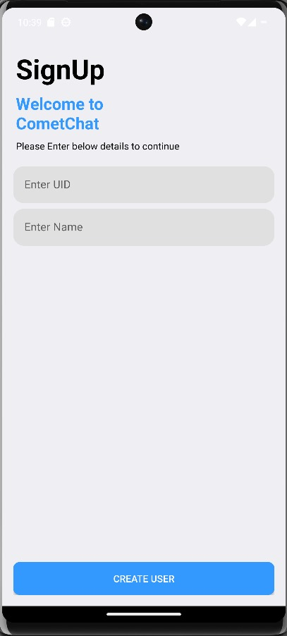
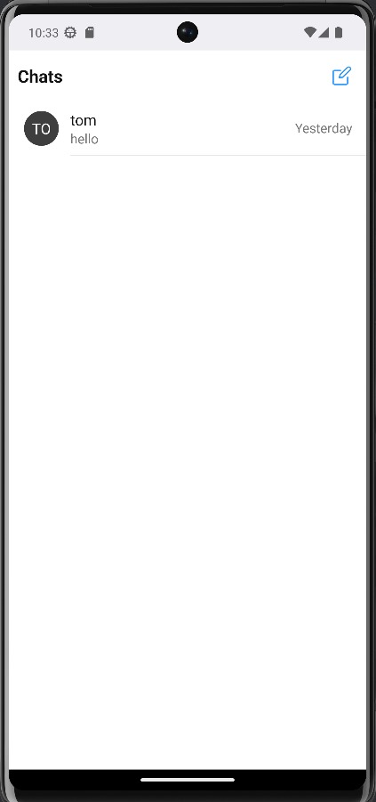
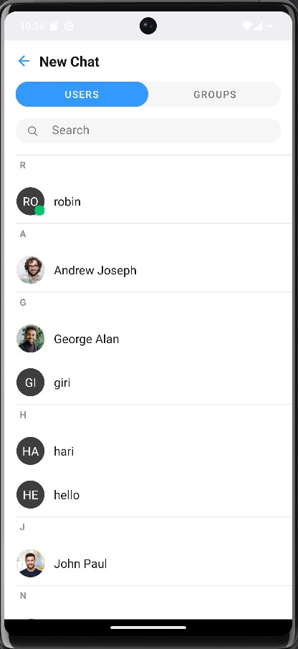
Output:

Slide 22
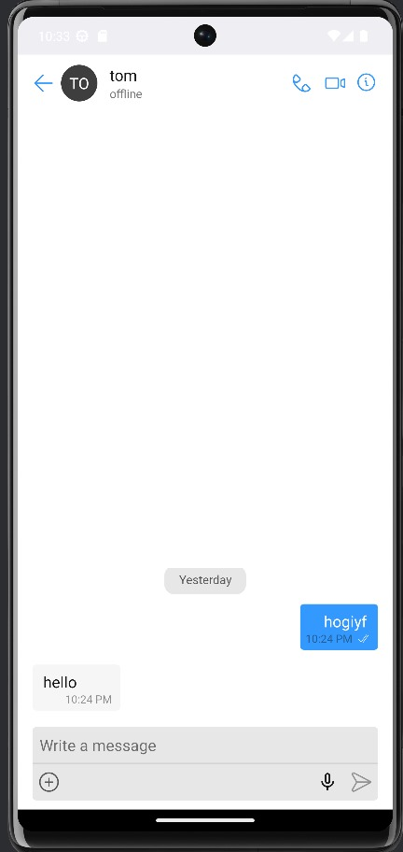
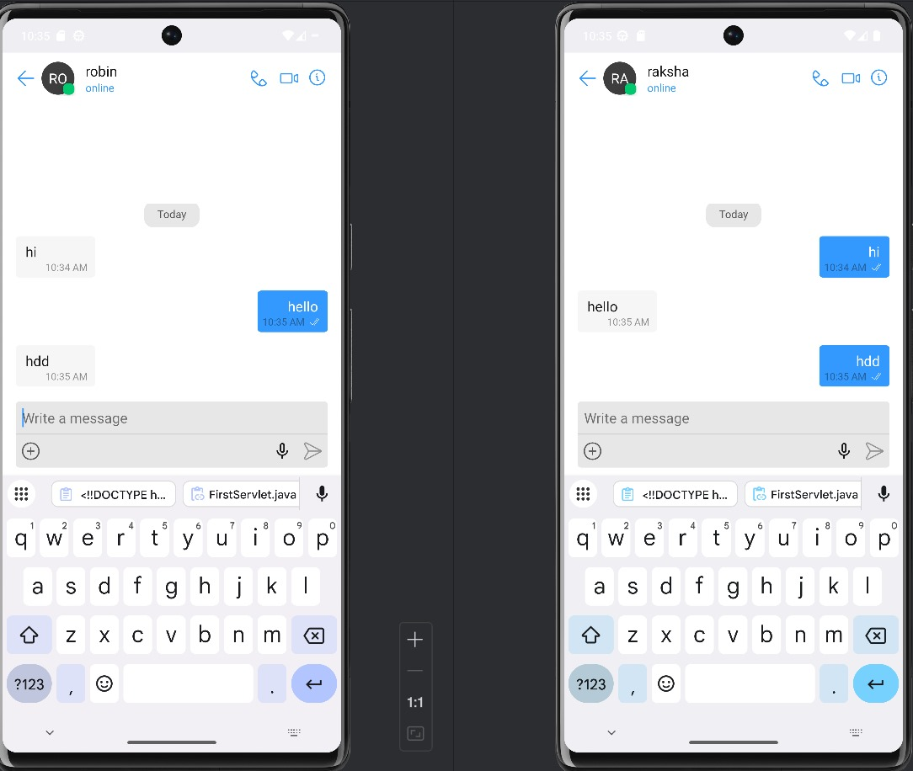

Slide 23
